Slide 1
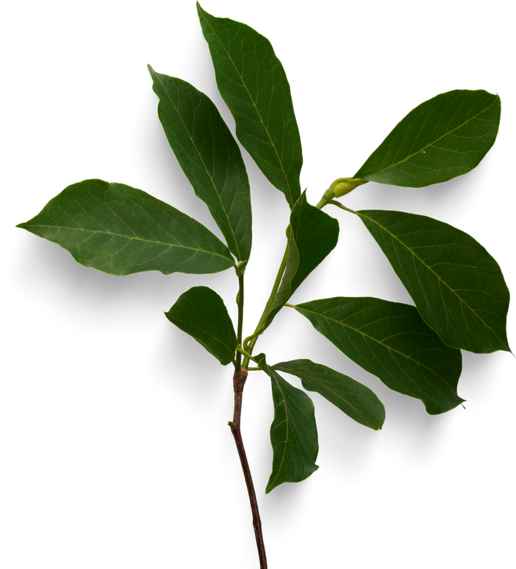
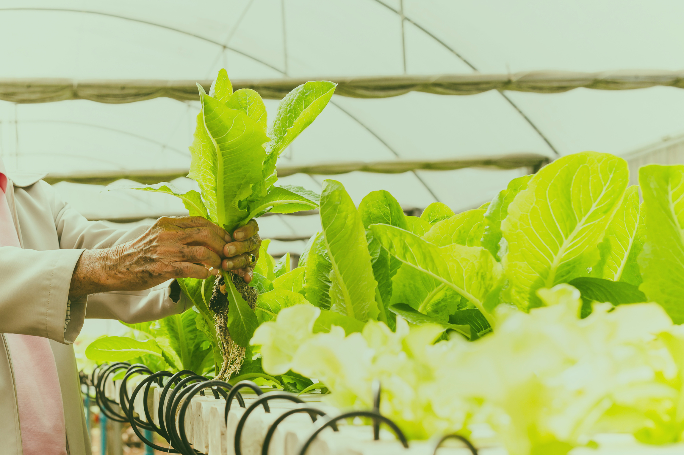



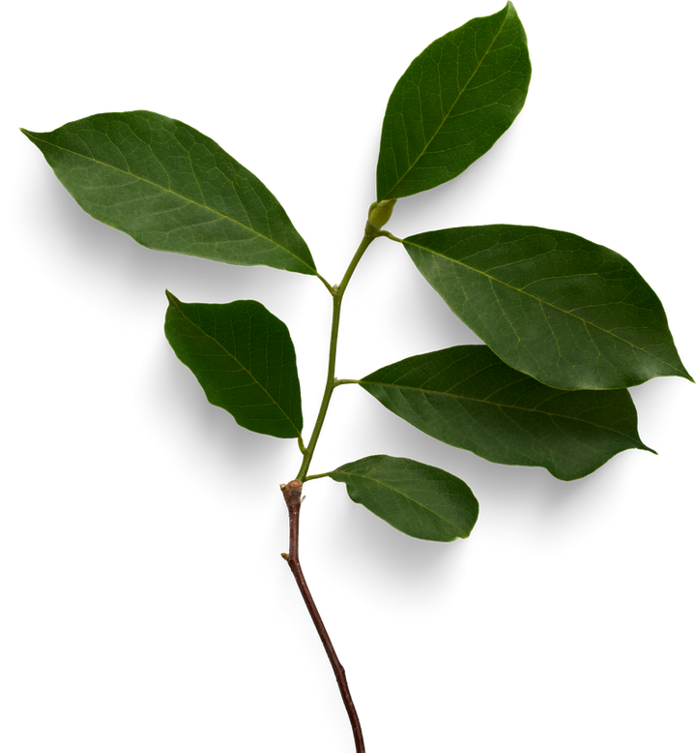
AGRICULTURE IN EGYPT

Slide 2

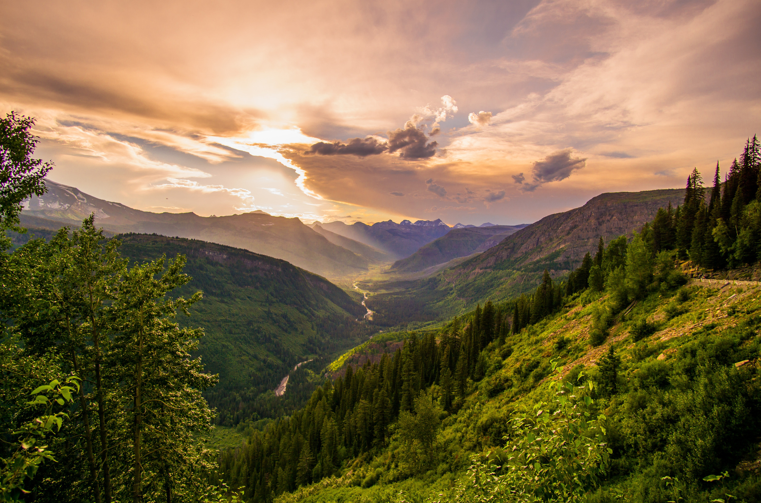
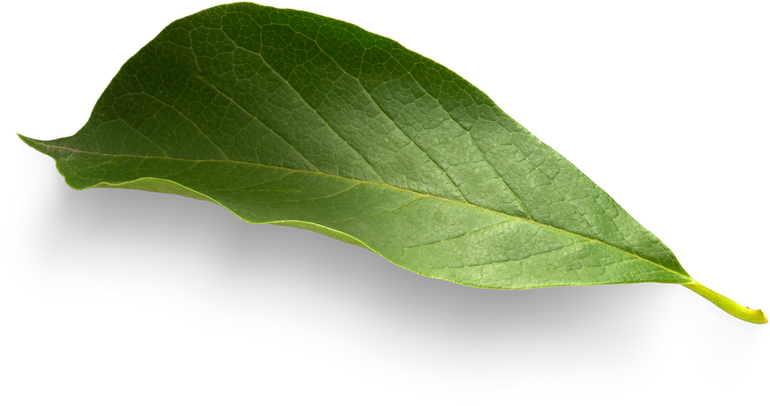

Steps include:
Data Loading & Cleaning
Exploratory Data Analysis (EDA)
Baseline Model Training
Evaluation & Metrics
Repository Setup (GitHub)
Deliverables:
Clean dataset
EDA report with visuals
Baseline ML model + metrics
Fully documented GitHub repo
Wardiere Inc.
Project Overview

Slide 3
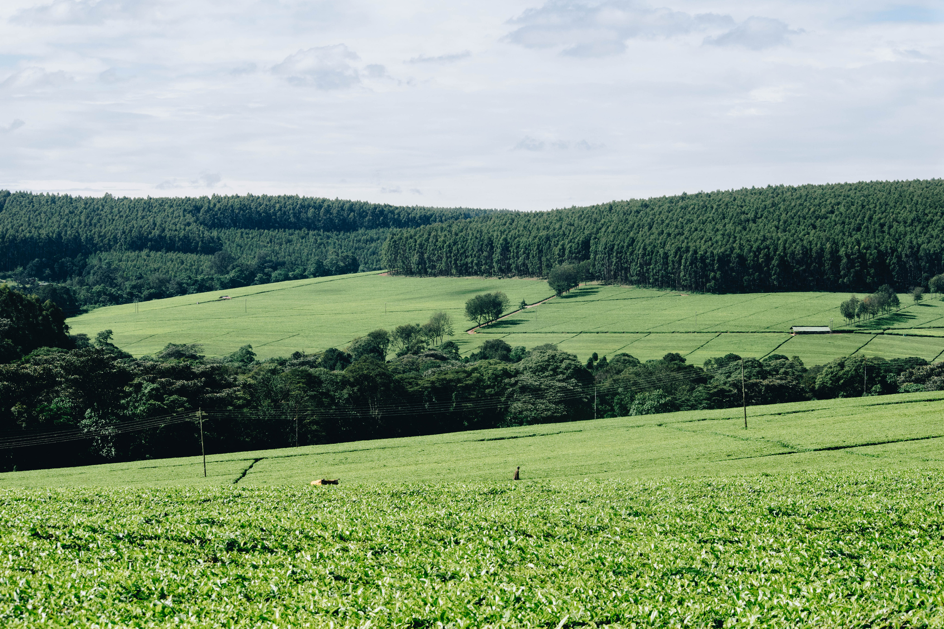
Wardiere Inc.
Load raw plant images from folders or dataset source.
Remove corrupted or unreadable images (wrong format, broken file, zero-size).
Ensure consistent class folder structure (each plant species in its own folder).
Resize all images to the same resolution (e.g., 224×224).
Normalize pixel values
0–255 → 0–1 or
Standard normalization (mean/std) for CNNs.
Data Pipeline
From Raw Data to Train/Test

Slide 4
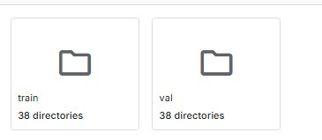
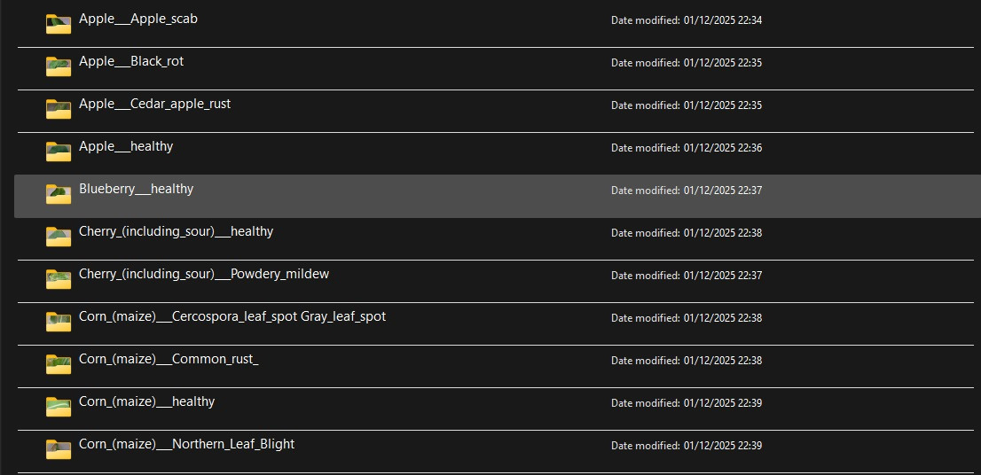
No Data Spliting ( Default )
If the dataset already comes with its own predefined structure (common in image datasets), then no manual splitting is needed.
✔ What it means:
The dataset is already organized into folders such as:
train (43444)
test (10861)
Each folder already contains the correct plant images for that split.
You simply load the images as they are — no need to split manually.

Slide 5
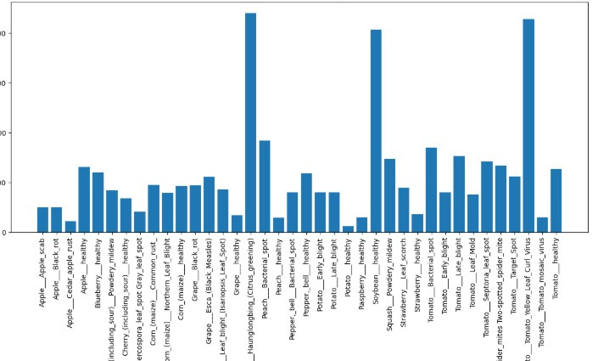
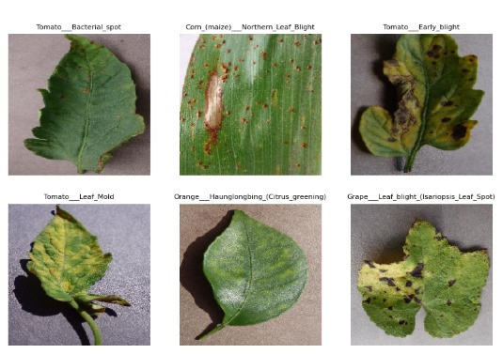
CLASS DISTRIBUTION
RANDOM SAMPLE

Slide 6
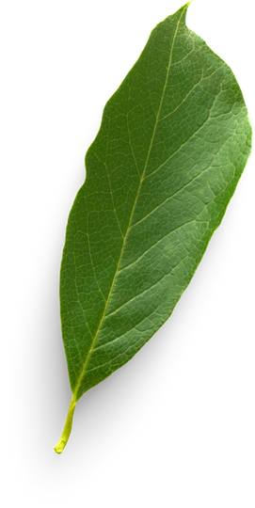
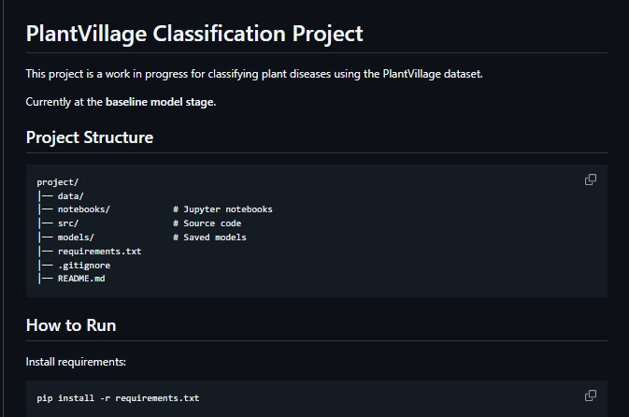
Our Repo
https://github.com/AbdulrhmanHelmy/plant-village-ml

Slide 7
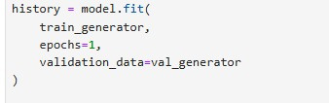
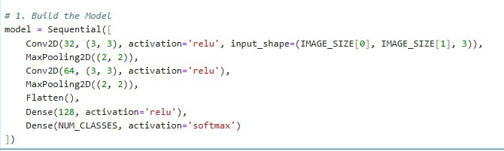
Base Line Model
The Validation accuracy is 70%

Slide 8

Thank You.

